Slide 1
Introduction to ASP.NET Core Tag Helpers
Scott Sauber
@scottsauber

Slide 2
Audience
Assuming you’re familiar with ASP.NET MVC (4.6 or Core)
Assuming you’re at least briefly familiar with ASP.NET Core
Though not super important

Slide 3
Who am I?
Software Developer, working primarily with web and ASP.NET
Worked with the .NET since 2009
Avid learner
Following ASP.NET Core since the early days

Slide 4
Scope
Intro talk, but going to dive deep into Tag Helpers
What is ASP.NET Core? (brief)
What’s wrong with HTML Helpers?
What are Tag Helpers?
What are benefits over HTML Helpers?
Side-by-side comparisons
Built-in Tag Helpers
Making a custom Tag Helper

Slide 5
What is ASP.NET Core?
Brand new ASP.NET Stack written from scratch
Just released 1.0 to RTM on June 27th
Open Source
Cross-platform
Extremely modular
Tag Helpers are an ASP.NET Core feature only, will not be ported to ASP.NET 4.6 anytime soon, if ever

Slide 6
HTML Helpers
Who uses HTML Helpers?
Who likes them?

Slide 7
Example of a super basic HTML Helper
Developer code:
HTML Generated:
Browser Rendered:

Slide 8

As a Dev, I feel….

Slide 9
Example of a more advanced HTML Helper
Developer code:
HTML Generated:
Browser Rendered:

Slide 10

As a Dev, I feel….

Slide 11

Example of even more advanced HTML Helper
Developer code:
HTML Generated:
Browser Rendered:

Slide 12

As a Dev, I feel….

Slide 13
…or how about the Form HTML Helper

Slide 14

As a Dev, I feel….

Slide 15
What’s wrong with HTML Helpers?
Writing C# instead of HTML Markup
Feels less natural
Designers don’t like it
Less portable if going client-side
Fighting the editor for anything but super basic scenarios
Some helpers are especially painful
Looking at you form tags

Slide 16
So what are Tag Helpers?
Tag helpers lets server side code participate in the rendering of an HTML element, while still maintaining a great development experience.

Slide 17
Tag Helper vs HTML Helper
Tag Helper:
HTML Helper:

Slide 18
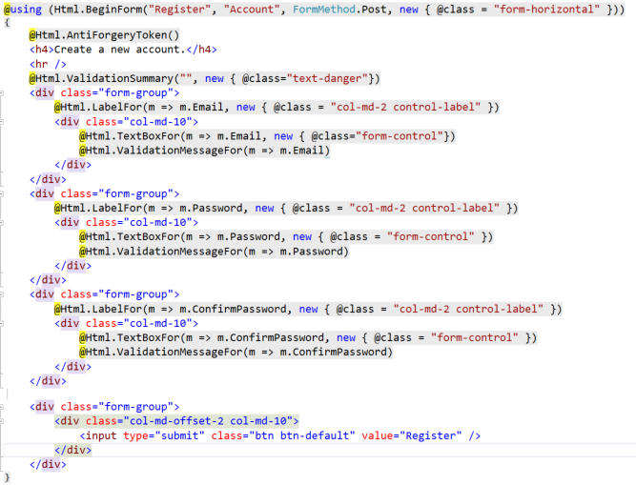
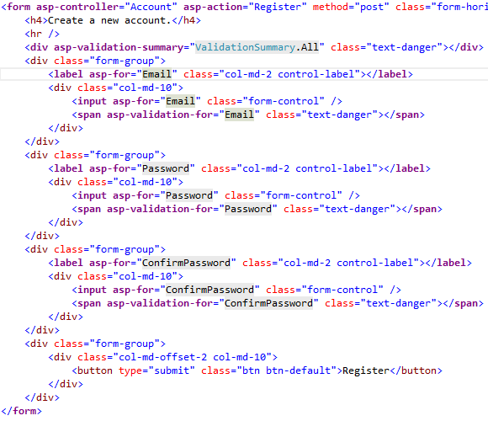
HTML Helpers Tag Helpers

Slide 19
Benefits of Tag Helpers?
Better developer experience with existing tooling
Easier readability and less context switching
Easier to hand off to people familiar with HTML not C#
Easier to transition to different framework if needed

Slide 20
Conventions of Tag Helpers
Tag Helpers turn purple
Make sure to build your project first
Attributes will have an asp- at the beginning of them to signify they are server side.
By default, Tag Helpers do not require a pre-fix at the beginning of the HTML Element
This is configurable via _ViewStart.cshtml then adding @tagHelperPrefix th:
This will make th required at the beginning of every tag helper
<th:label class=“control-label” asp-for=“City”></th:label>
https://github.com/aspnet/Razor/issues/88

Slide 21
Conventions of Tag Helpers (continued)
You can create your own tag helper
Suffix your TagHelper with the word TagHelper like HelloWorldTagHelper
By convention, names like HelloWorldTagHelper that are Pascal Cased will need to be used like <hello-world> with the – in between the two upper cased words
Lower kebab casing

Slide 22
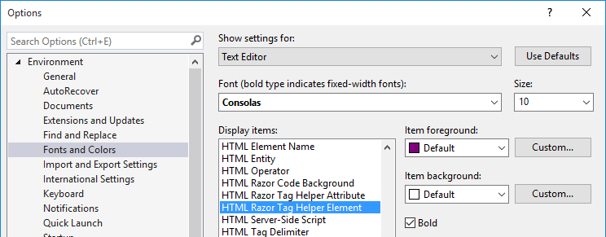
Customizing the Tag Helper font
Go to Tools => Options => Environments => Fonts and Colors

Slide 23
How to enable Tag Helpers
Go to /Views/_ViewImports.cshtml
Old /Views/web.config, essentially
Add this line to use Microsoft delivered TagHelpers: @addTagHelper *, Microsoft.AspNetCore.Mvc.TagHelpers
Add this line to use your own custom Tag Helpers: @addTagHelper *, RootNamespaceHere
To remove Tag Helpers (for some reason): @removeTagHelper *, Microsoft.AspNetCore.Mvc.TagHelpers

Slide 24
More on _ViewImports.cshtml
Any folder inside your view folder can add a _ViewImports.cshtml so that it scopes to just that folder

Slide 25
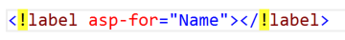
Opt out of individual elements
Add a ! To the beginning of the opening and closing tag.

Slide 26
Built-in Tag Helpers

Slide 27
Labels
Developer code:
<label asp-for="Name"></label>
HTML Generated:
<label for="Name">Name</label>

Slide 28
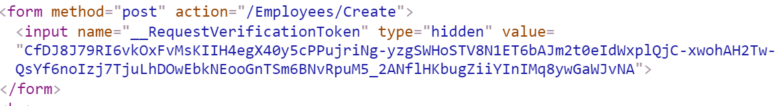
Forms
Developer code:
<form method="post" asp-controller="Employees" asp-action="Create">
@* Some form inputs here *@
</form>
HTML Generated:

Slide 29
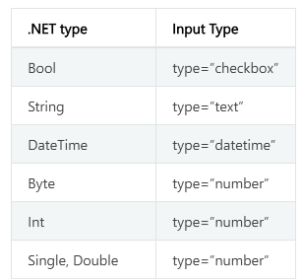
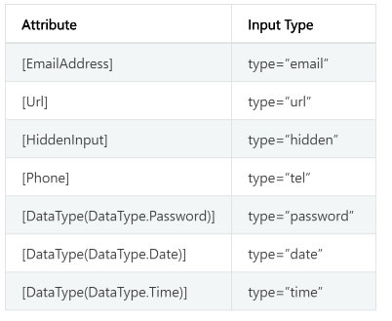
Input
Developer code:
<input asp-for="Name" />
HTML Generated:

Slide 30
Text Area
Developer code:
<textarea asp-for="Name"></textarea>
HTML Generated:

Slide 31
Validation Messages
Developer code:
<span asp-validation-for="Name" class="text-danger"></span>
HTML Generated:

Slide 32
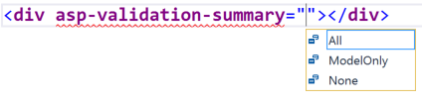
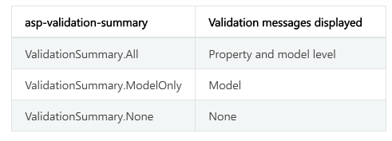
Validation Summary

Slide 33
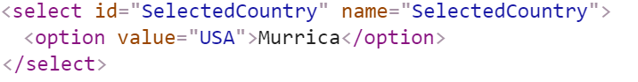
Select
Developer code:
<select asp-for="SelectedCountry" asp-items="Model.Countries"></select>
HTML Generated:

Slide 34
And now for the cool Tag Helpers…

Slide 35
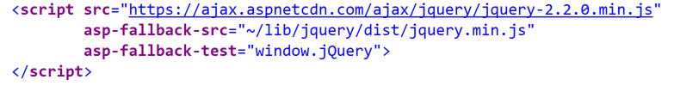
Script

Slide 36
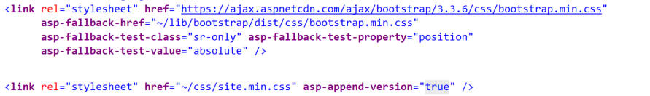
Stylesheets

Slide 37
Images

Slide 38
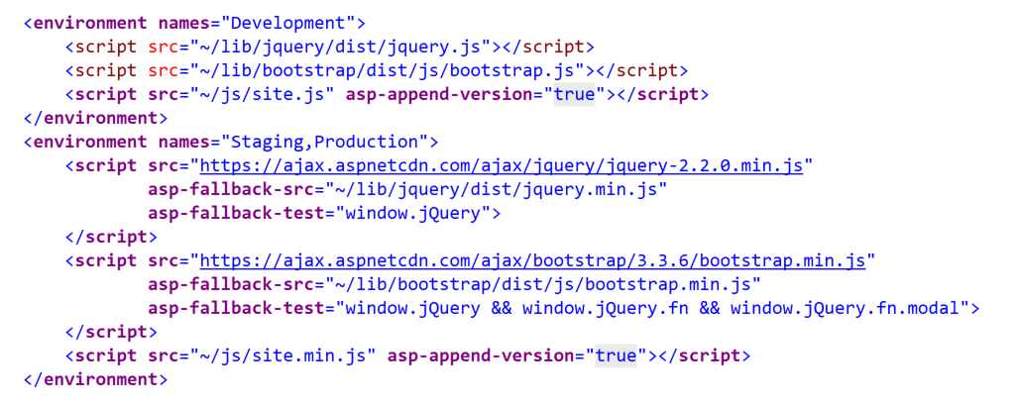
The Environment Tag Helper

Slide 39
Cache Tag Helper
<cache expires-after="TimeSpan.FromSeconds(10)">
Last Updated <strong>@DateTime.Now</strong>
</cache>

Slide 40
Distributed Cache Tag Helper
Cache Tag Helper is stored in memory
Lost when process restarts
Distributed gives you way of storing that more permanently
SQL Server and Redis are supported providers
If none specified, uses memory (nice for dev)

Slide 41
Distributed Cache Helper (continued)
<distributed-cache name="SomeUniqueName" vary-by-query="iowacodecamp">
This will be cached in in a database
</distributed-cache>

Slide 42
Distributed Cache Helper (continued)
More info: http://www.davepaquette.com/archive/2016/05/22/ASP-NET-Core-Distributed-Cache-Tag-Helper.aspx

Slide 43
HTML Helpers are still in ASP.NET Core
So if you don’t like tag helpers, then keep using your HTML Helpers

Slide 44
Let’s make a custom tag helper
By convention, we should end our tag

Slide 45
3rd Party Support
Telerik
DevExpress

Slide 46
Source code and Power Point
https://github.com/scottsauber/ICC17TagHelpers

Slide 47
Resources
Official Documentation of Tag Helpers
https://docs.asp.net/en/latest/mvc/views/tag-helpers/index.html
Bootstrap Tag Helpers
https://github.com/dpaquette/TagHelperSamples
Founding father of Tag Helpers
https://twitter.com/ntaylormullen

Slide 48
Questions?

Slide 49
Thanks!

